Slide 1
Discussion 13: A* Search and MST’s
Christine Zhou

Slide 2
Agenda
Announcements
Review: Dijkstra’s and A* Search
Problem 1
Review: MST’s
Problem 2

Slide 3
Announcements
Long time no see! :’)
HW7 due tomorrow!
Proj3: Fun with Graphs!
Due 12/5, Wednesday of dead week
Last lab is this week! :O
Tentative dead week schedule:
Discussion section as usual
Lab sections
Take part in a study for extra credit!
OH as usual
Attendance: tinyurl.com/cz-disc13-fa18

Slide 4
Dijkstra’s Algorithm
Any lingering questions about Dijkstra’s algorithm?
What if we only wanted to find a path from SF to NYC? Would Dijkstra’s work?
Yes, but we can do better...

Slide 5
A* Search
Useful when we have a single target in mind, we only search in a direction that brings us closer to our goal
Introduce heuristics: an estimate from any vertex to the goal vertex
These values will be provided for you by someone/something
Do the same procedure as Dijkstra’s, except add “distTo(v) + h(v,g)” to the fringe instead of “distTo(v)”
h(v,g) = estimate from v to the goal
Fringe will contain total distances from the start to the end
Explore the path to the goal that is the smallest, according to our heuristic
Keep exploring until we have popped off the goal

Slide 6
Heuristics
Admissible: heuristic cannot overestimate distance from the current vertex to the goal
Consistent: change in heuristic between v and w cannot exceed actual change in distance between v and w

Slide 7
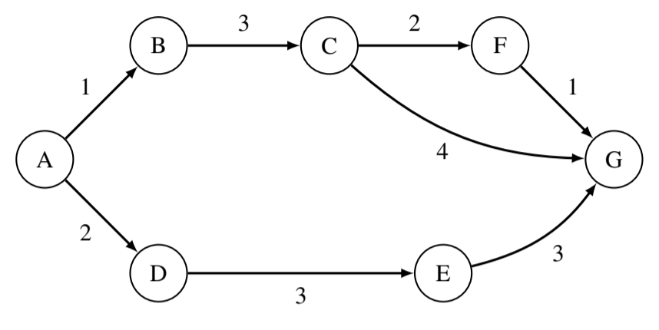
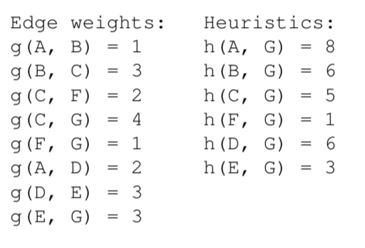
1 A* Search
Given the weights and heuristic values for the graph below, what path would A* search return, starting from A and with G as a goal?
Is the heuristic admissible? Why or why not? A heuristic is admissible if it never overestimates the distance it is estimating.

Slide 8
Minimum Spanning Trees
Tree: if there are V vertices, the graph must have V-1 edges
no cycles!
Spanning: the set of edges must connect all vertices
Minimum: the spanning tree must have the smallest total weight
Minimum spanning tree (MST): a tree that connects all vertices with the smallest total weight

Slide 9
Prim’s Algorithm
Pick an arbitrary starting point
Always pick the minimum edge that is connected to the graph you are building up that connects to a vertex not already in the graph
Does this seem familiar?
It’s exploring how Dijkstra’s algorithm would explore!

Slide 10
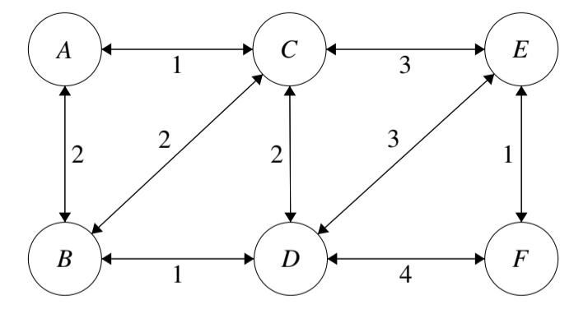
2 Minimum Spanning Trees
Perform Prim’s algorithm to find the minimum spanning tree of the above graph. Pick A as the initial node. Whenever there are more than one node with the same cost, process them in alphabetical order. (BE comes before CE)

Slide 11
Kruskal’s Algorithm
Always pick the minimum edge (unless it creates a cycle)
How do we check cycles?

Slide 12
Quick Union!
Used to represent connectivity between items
Each item belongs to its own set, “union” the items together by connecting the sets together, “find” the set the item belongs to
Sets will have a tree like structure
Optimizations:
Union by weight: connect the root of the “lighter” set to the root of the “heavier” set (determined by number of nodes in the set)
Path compression: when you “find” a node, compress the node and the path to the node by connecting it to the root of the set
61BL Lab about Disjoint Sets

Slide 13
Weighted Quick Union with Path Compression
0
1
2
3
4
5
Let’s union(0, 1) and union(2, 3)!

Slide 14
Weighted Quick Union with Path Compression
0
2
4
5
1
3
Union roots by weight
If weights of the sets are the same, tie break (choose the set with the smaller root value as the new root)
Now let’s union (1, 3)!

Slide 15
Weighted Quick Union with Path Compression
0
4
5
1
2
3
Union roots by weight
If weights of the sets are the same, tie break (choose the set with the smaller root value as the new root)
Notice we only union roots to each other
What would happen if we did “find(3)”?

Slide 16
Weighted Quick Union with Path Compression
0
4
5
1
2
3
We are using a weighted quick union with path compression
The path from 3 to the root will be compressed (everything along the path from that node to the root wil nowl be connected directly to the root).
What if we do “union(3, 4)”?

Slide 17
Weighted Quick Union with Path Compression
0
5
1
2
3
4
Union roots by weight
The root of the smaller set (4) will be unioned to the root of the larger set (0-1-2-3).
What if for this step we unioned the root of the larger set to the root of the smaller set instead?

Slide 18
Weighted Quick Union with Path Compression
4
5
0
1
2
3
This structure is taller! Taller ⇔ bad! This is why we union the root of smaller sets to the root of larger sets.

Slide 19
2 Minimum Spanning Trees
b) Use Kruskal’s algorithm to find a minimum spanning tree. Is it the same as the one found by Prim’s?
c) Draw the resulting WQU tree at the end of the execution of Kruskal’s. When there are ties, choose the root to be the alphabetically first node. (There may be multiple possible answers)

